Slide 1
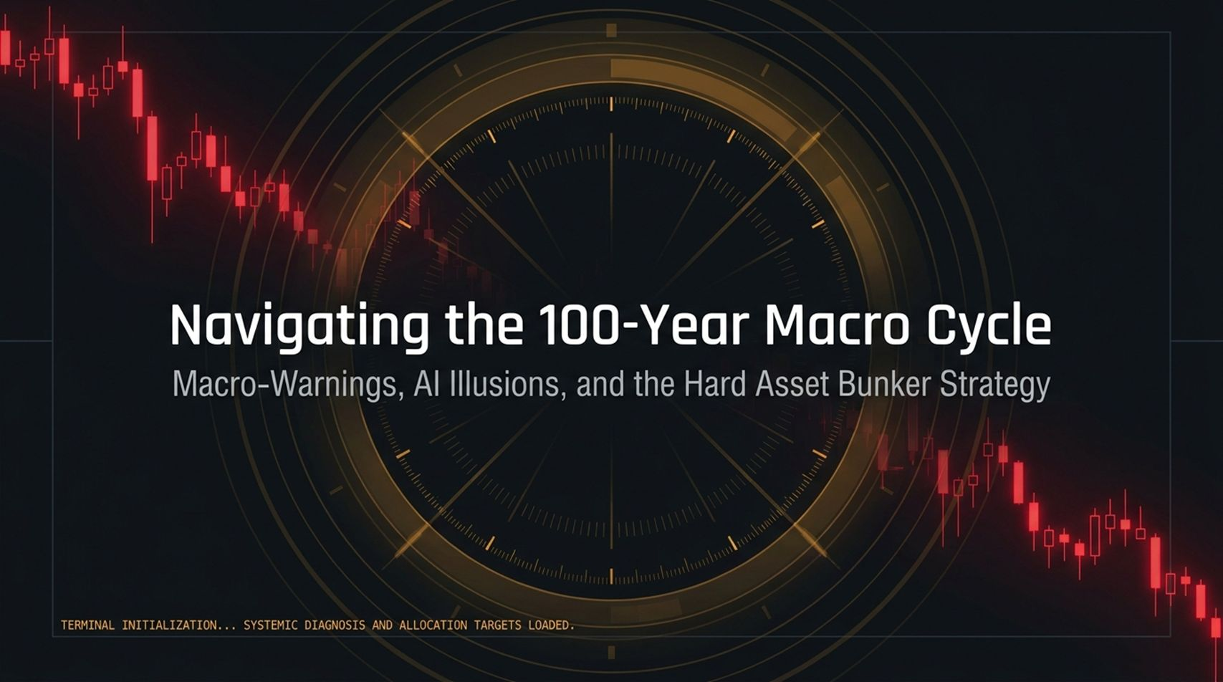
Notes:
Welcome the audience and frame the primary thesis: We are approaching an unavoidable 100-year cyclical climax mirroring the loose money, excessive leverage, and debt-fueled backdrop of the late 1920s.
Introduce the key drivers covered today: the $40 Trillion U.S. debt spiral, monetary interventions, and the AI Capex bubble, which is currently being artificially supported by circular vendor financing.
Introduce the alternative strategy: Building a "Hard Asset Bunker Portfolio" around physical gold, digital non-fiat assets (Bitcoin), and contrarian deep-value plays like Chinese equities.
https://www.youtube.com/watch?v=chewWgxS8gc

Slide 2
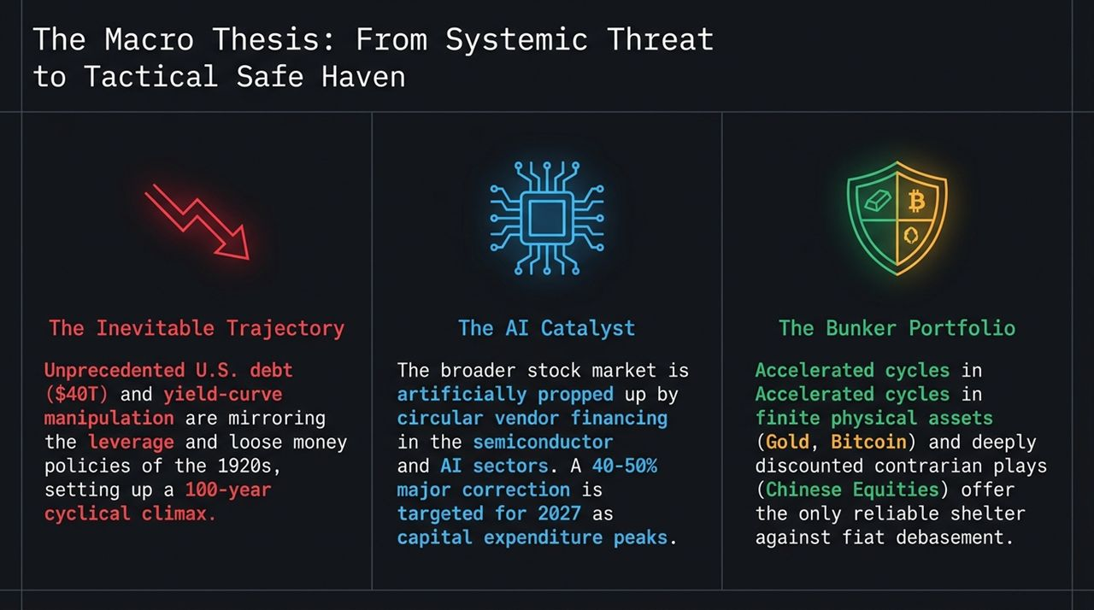
Notes:
The Interventions: Explain how the core economy is being artificially sustained through $2 Trillion annual deficit spending and Treasury yield curve interventions.
The Structural Reality: Highlight how de-dollarization erodes U.S. purchasing power abroad, effectively importing inflation into everyday consumer goods.
The Medical Metaphor: Analogize the Fed and U.S. Treasury to doctors administering larger and larger doses of liquidity to keep a flatlining patient alive.

Slide 3
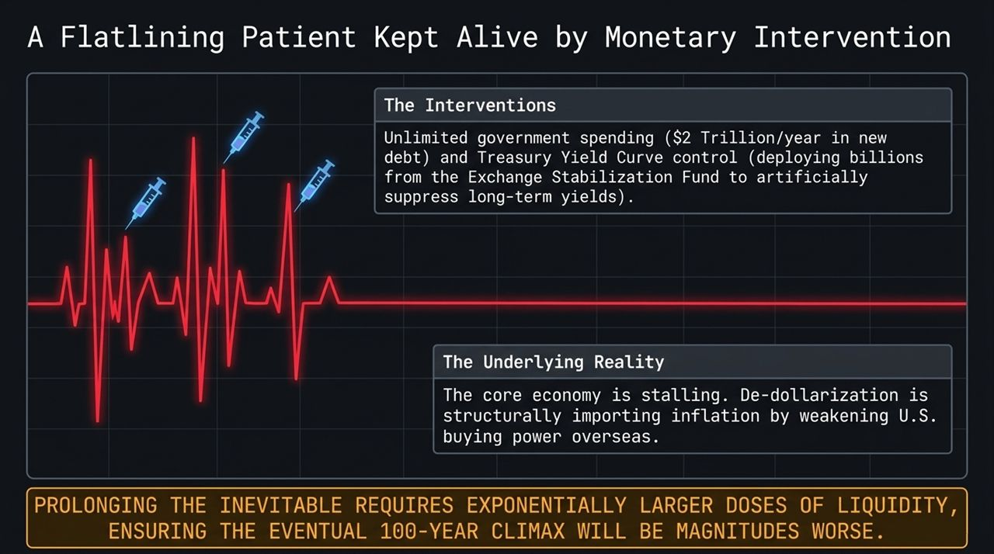
Notes:
The Math: Frame $40 Trillion in total U.S. debt and $1 Trillion+ in annual interest payments as a mathematical dilemma: the Fed cannot aggressively cut rates without triggering inflation, but cannot maintain high rates without breaking Treasury solvency.
The 5% Yield Trigger: Detail how 10-year Treasury yields approaching 5% act as an immediate market trigger for a ~20% drawdown in equity markets.
The Hawkish Bluff: Explain Fed Chair Kevin Warsh's hawkish rhetoric at Jackson Hole as a strategic "bluff" to talk financial conditions down without needing to enact physical rate hikes.

Slide 4
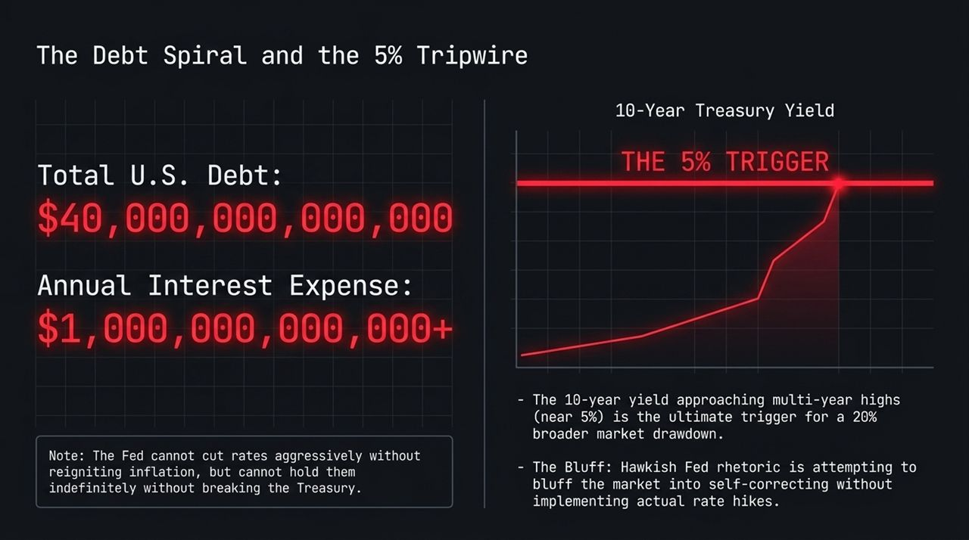
Notes:
The Echoes of 2000: Compare the current AI boom to the dot-com telecom vendor financing collapse of 2000.
The Mechanics: Break down the circular funding loop: Semiconductor giants (e.g., Nvidia) invest billions into startups, which are then contractually bound or incentivized to buy back hardware/chips from those same giants.
The Risk: Emphasize that while reported revenues look historic (e.g., 106% YoY), the underlying loop breaks as soon as external capex spend reaches its natural ceiling.

Slide 5
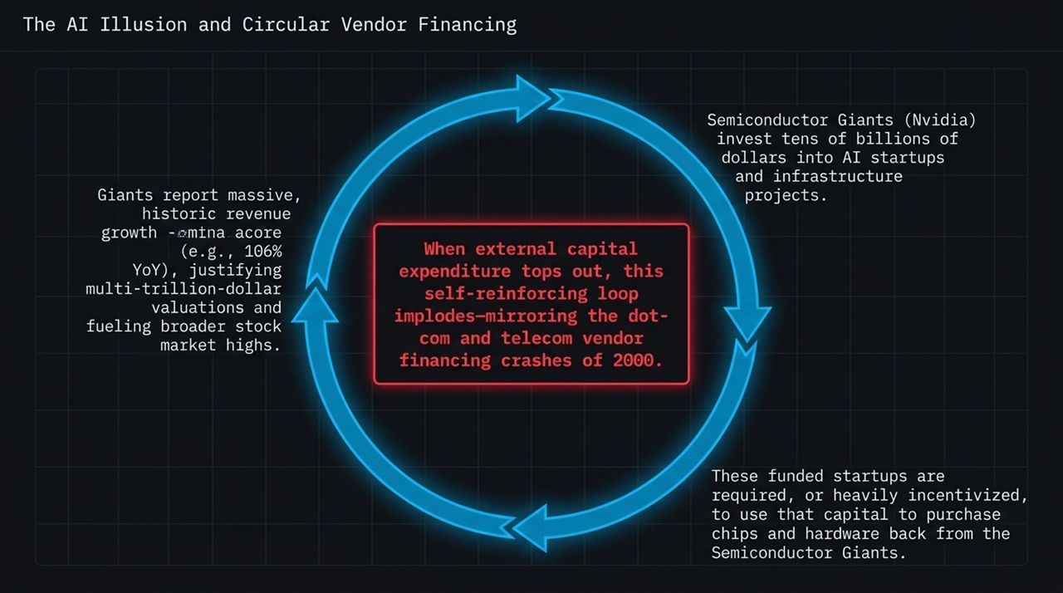
Notes:
Nvidia (NVDA): Frame NVDA as the barometer for the entire $5 Trillion tech market. Point out the critical $200 ascending support line—a breakdown below $200 indicates institutional smart money taking profits and exiting.
Micron (MU): Discuss Micron's chart as evidence that memory semiconductor cycle margins have peaked, targeting a 75% retracement down to $450.
Institutional Sentiment: Explain why record earnings releases can trigger sell-offs when institutional money unloads into retail buying strength.

Slide 6
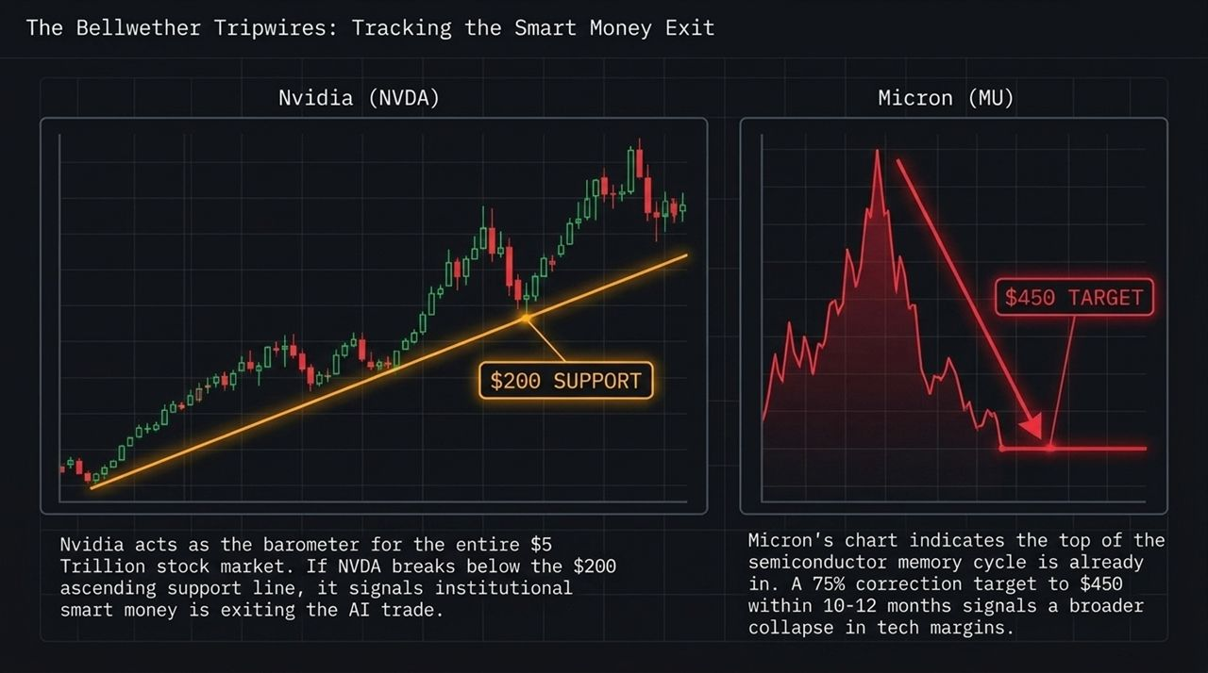
Notes:
Phase 1 (2026/Current): The Bluff & Prop: Administration utilizes yield curve control, dovish jawboning, and reserve deployments to hold equity markets up through the midterm election window.
Phase 2 (2027): The AI Reckoning: Hyperscaler Capex tops out, triggering debt market degradation, a credit shock, and a 40–50% broader stock market correction.
Phase 3 (2030–2031): The 100-Year Reset: Debt maturity convergence, fiat mistrust, and economic stagnation culminate in a full systemic reset.

Slide 7
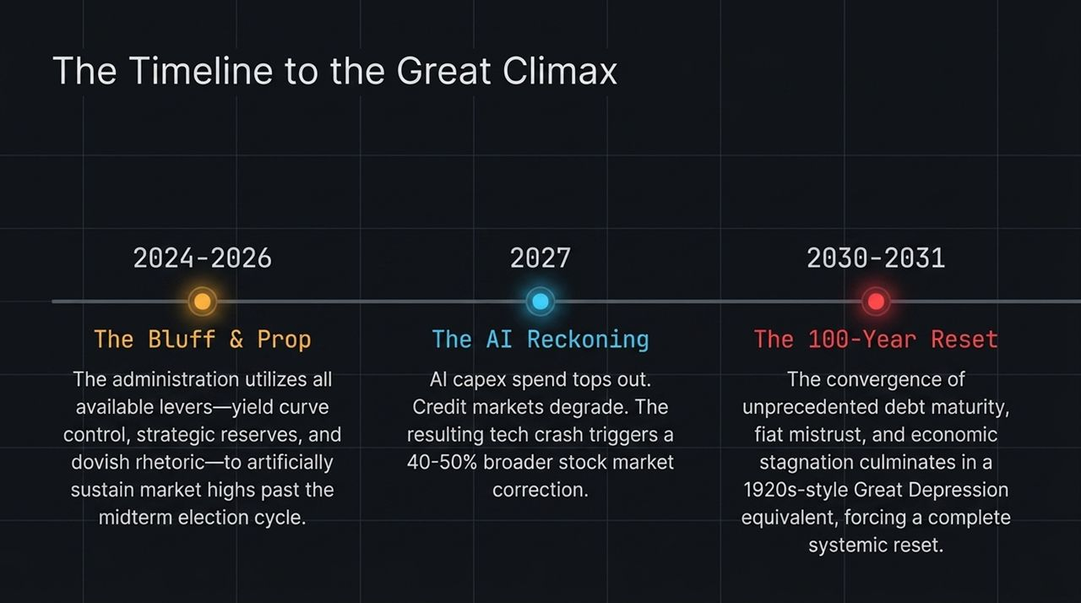
Notes:
Technical Setup: WTI Crude filled its $120 to $70 gap and is now compressing inside a technical wedge pattern.
Path A (Base Case - Deflationary): Without new Middle Eastern escalations, economic demand destruction takes control, dragging crude down to $50/barrel by early 2027.
Path B (Escalation Case - Inflationary): Post-midterm political freedom allows military escalation (e.g., Iran), sparking oil price spikes and forcing the Fed to abandon rate cuts.

Slide 8
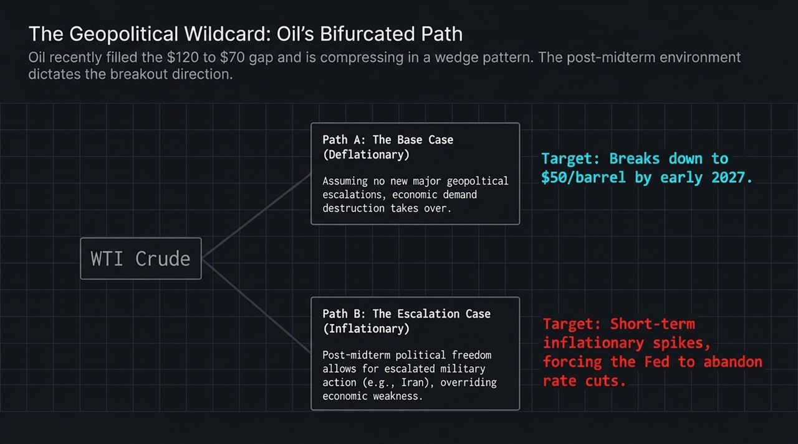
Notes:
The Silent Tax: Detail how a 4% inflation rate quietly degrades purchasing power (e.g., a $100k salary becomes $96k in real buying power in just 12 months).
The Trust Deficit: Explain how yield curve manipulation by central authorities erodes global institutional trust in sovereign debt and paper money.
The Bunker Solution: Capital must rotate into finite physical assets completely disconnected from balance sheet liabilities or endless supply expansion.

Slide 9
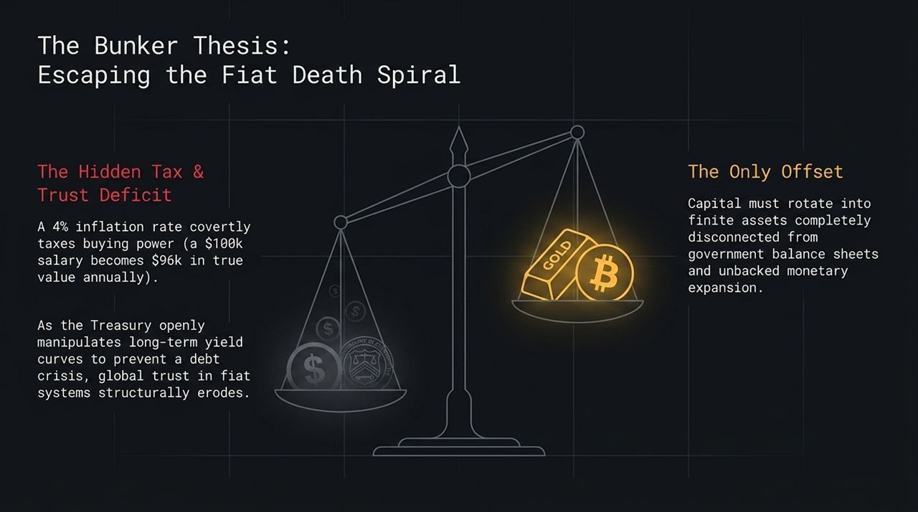
Notes:
Accelerating Velocity: Detail the macro inputs driving gold: $2.8T average annual debt issuance, ~9% M2 money growth, near-zero real interest rates, and sovereign central bank accumulation.
Compression of Cycles: Point out that past gold cycles took decades (1980 to 2011), but cycle velocity is accelerating due to compounding sovereign debt.
The Numerical Targets:
Near-term Buy Zone: Pullback to $3,500 – $4,000 offers an optimal entry point.
Cycle Peak Target: Mathematical cycle models project a peak between $13,000 and $15,000 by 2029–2031.

Slide 10
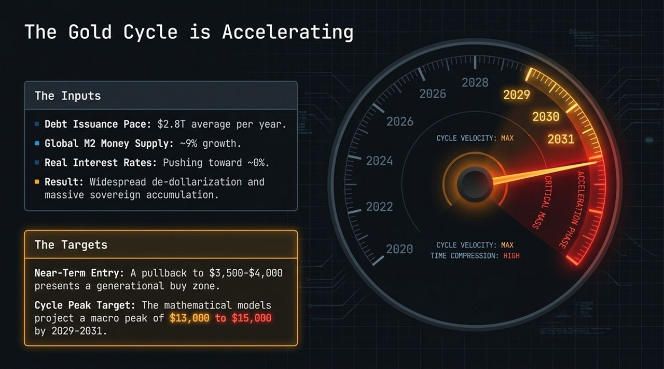
Notes:
The Bullish Case: Bitcoin broke out from its multi-year descending trendline, fueled by central bank yield curve interventions validating the anti-fiat narrative.
The Technical Risk: Caution that BTC has not yet established a macro "higher high." In a broader 2027 market liquidation, BTC remains vulnerable to a flush down to $35,000 – $50,000.
The 2030 Endgame: In a severe 2030–2031 fiat confidence crisis, Bitcoin serves as a main digital capital escape valve targeting $250,000+.

Slide 11
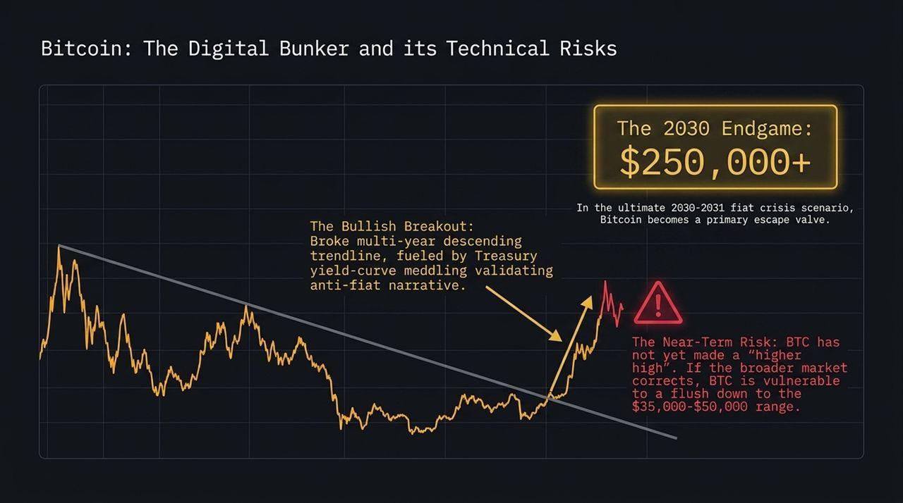
Notes:
Monetary Gold vs. Industrial Silver: Contrast Gold's status as a pure monetary store of value against Silver's heavy reliance on industrial usage.
The Risk Factor: An economic slowdown and AI data center/capex contraction directly harms industrial silver demand, dragging down its premium.
The Target: Bearish near-term bias; technical charts project a retest/retracement down toward the $50 range.

Slide 12
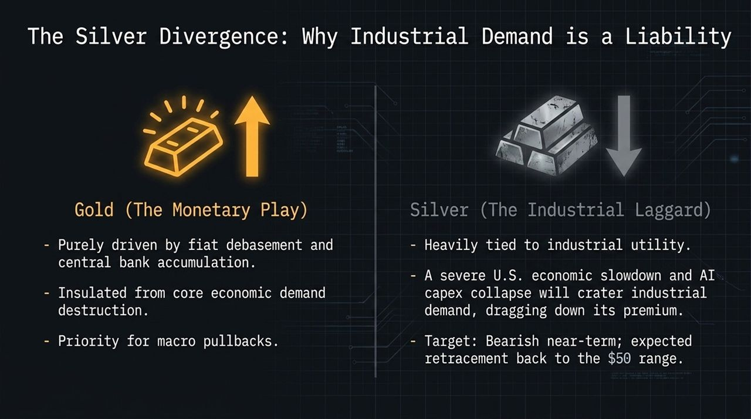
Notes:
U.S. Tech Exposure: High valuations priced for perfection; vulnerable to a capex slowdown and a 2027 economic contraction.
Chinese Equities Opportunity: Single-digit P/E ratios (6x–9x, e.g., BABA, BIDU); emerging from a multi-year real estate depression; backed by sovereign gold accumulation and open-source AI models.
The Trade Execution: Rotate capital from stretched U.S. tech names into deeply discounted Chinese internet/AI tech (KWEB, Alibaba, Baidu) for a projected 100–200% upside over the next 6–12 months.

Slide 13
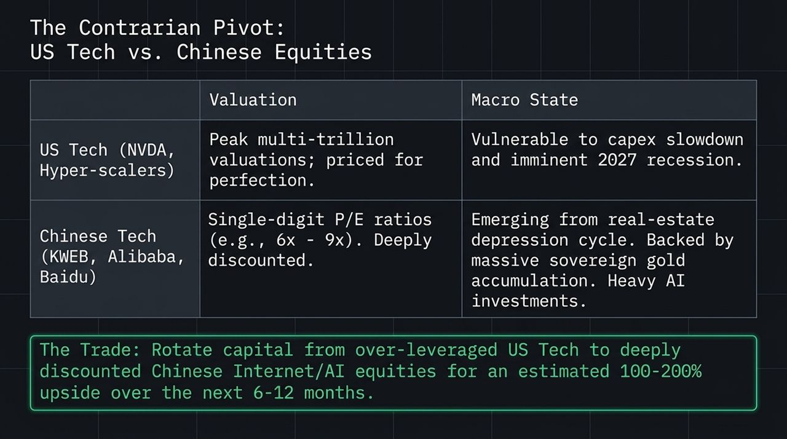
Notes:
Walk the audience line-by-line through the Summary Matrix:
Nvidia (NVDA): Bearish Proxy | Entry/Trigger: Break below $200 Support | Target: Broader tech crash.
Micron (MU): Bearish | Entry/Trigger: Top is in | Target: $450 (75% drop) in 10 months.
Gold: Bullish Bunker | Entry/Trigger: Pullback to $3,500 – $4,000 | Target: $13,000 – $15,000 by 2031.
Bitcoin: Bullish Long-Term | Entry/Trigger: $35,000 – $50,000 flush | Target: $250,000+ by 2031.
KWEB / BABA: Bullish Contrarian | Entry/Trigger: Current single-digit P/E | Target: +100% to +200% upside.
WTI Oil: Bearish Base Case | Entry/Trigger: Post-midterm demand Destruction | Target: $50/barrel by 2027.

Slide 14
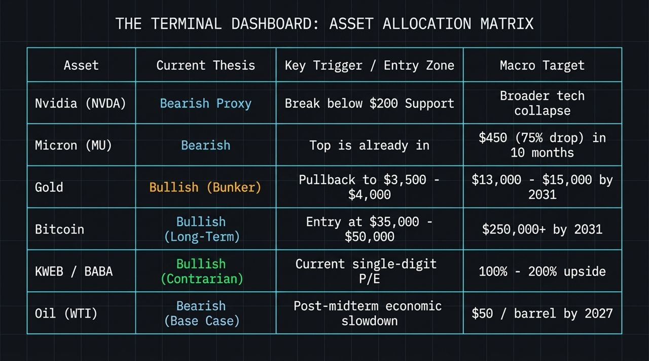
Notes:
The Fiscal Reset: The climax of the debt cycle will force a return to strict fiscal discipline, likely requiring a hard-asset (gold) backing for sovereign currencies to restore international trade trust.
The AI Paradox: While AI infrastructure capex triggers an initial credit bust and job losses, within 10–15 years AI will evolve into a powerful deflationary force driving real productivity.
Core Conclusion: Survive the 2027 liquidation period to preserve and deploy capital for the 2030 reconstruction phase.

Slide 15
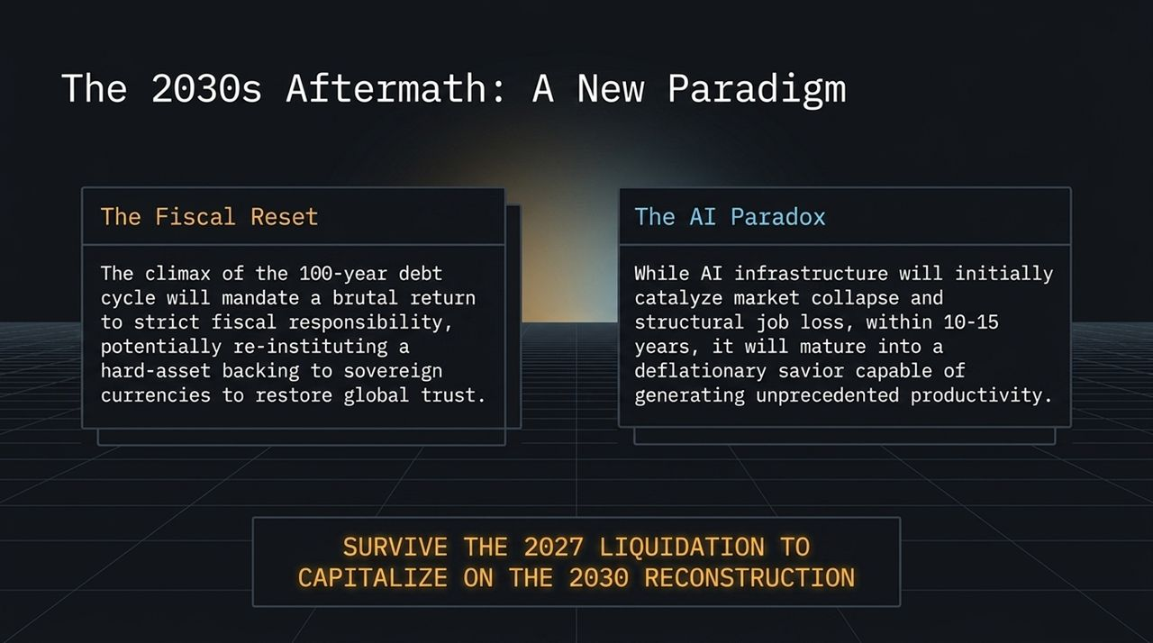
Notes:
The Deception Landscape: Address how AI democratizes deepfakes, moving beyond basic social media misinformation into sophisticated enterprise financial attacks. Note that ~50% of high-engagement online content is synthetic or manipulated.
Threat Actors: Highlight threat profiles ranging from state-sponsored entities seeking IP theft to cybercriminals executing financial wire fraud.
Operational Rules: Walk through corporate defense protocols: deploy "Trust Advisors" (real-time video/audio synthetic analysis), eliminate unverified "cavalier" call joiners, and shift tech policy toward strict product liability.

Slide 16

Notes:
Summarize the three main takeaways:
Monitor Tech Tripwires: Watch NVDA $200 support line and Treasury yields closely.
Accumulate Real Bunker Assets: Buy gold on pullbacks ($3,500–$4,000 zone) and keep dry powder for Bitcoin dips ($35k–$50k).
Rotate to Contrarian Value: Reallocate out of overextended U.S. tech into undervalued Chinese internet/AI assets.
Transition to Q&A with the audience.

